Slide 1
M.A.S.K Online Shop
Team 3:
Mohammad Mhsoun
Shujat Ali
Sowjanya Penmetsa
Kaviya Ayyappan

Slide 2
Headlines
Inroduction
Methodology
Mockup
Task Completed
Task Remaining
Prototype

Slide 3
Introduction
Background
Customer (M-A-S-K)need an Online Shop
We have design a website for MASK where the people can shop electronic products online.

Slide 4
Scrum/Agile workflow
Sprint 1
https://trello.com/b/ohPe13MF/mask-sprint1
Sprint 2
https://trello.com/b/9CDhPyi6/mask-sprint2

Slide 5
UI/UX Mockup Design
https://balsamiq.cloud/skz5gt7/piam4wz/r9D98

Slide 6
Technologies
Version Control system (Git)
Sprint planning : Trello
Bootstrap 4
Editor : Visual Studio
Database : MS SQL Server
Razor View Pages
JQuery
Font-Awsome

Slide 7
Task
Registration
Authorization and Authentication
Product Search option
Admin - Product (CRUD)
Product Details with Zooming
Rating and Review option
Wish list

Slide 8
Task
Add to Cart
Product Filtering
Checkout

Slide 9
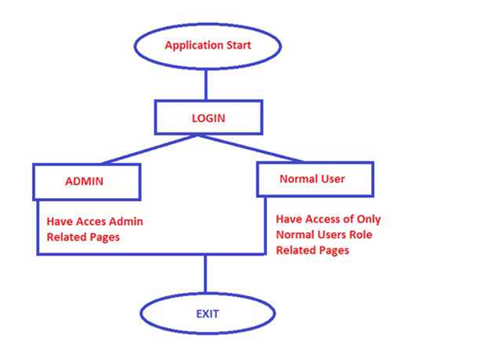
Login

Slide 10
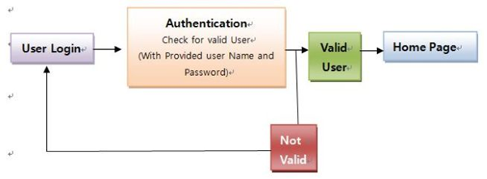
Authentication

Slide 11
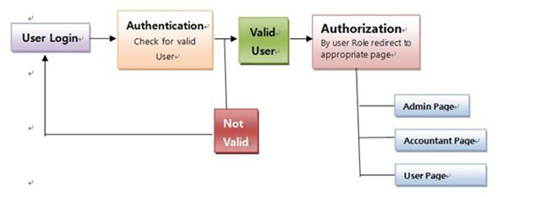
Authorization

Slide 12
Future Plans
Track My package page
Payment System
Login with Google
Code Testing

Slide 13
Project Demonstration

Slide 14
Thank You
Any Questions ?

